Slide 1




LENDI INSTITUTE OF ENGINEERING AND TECHNOLOGY
(Autonomous)
Approved by AICTE and Permanently affiliated to JNTU Gurajada-Vizianagaram.
ECE,EEE,CSE&MECH
DEPARTMENT OF COMPUTER SCIENCE AND ENGINEERING
NAME OF THE SUBJECT : Distributed System
NAME OF THE TOPIC : Distributed Objects and Remote Invocation
PRESENTED BY :
Mr. Satish Dekka
Assoc Professor

Slide 2
Content:-
  Introduction
  Communication between Distributed Objects
  Object Model
  Distributed Object Model
  Design Issues for RMI
  Implementation of RMI
  Distributed Garbage Collection
  Remote Procedure Call
  Events and Notifications
  Case Study: JAVA RMI

Slide 3
Introduction
A distributed object is an object that can be accessed remotely. This means that a distributed object can be used like a regular object, but from anywhere on the network.
Distributed objects might be used :
1. To share information across applications or users.
2. To synchronize activity across several machines.
3. To increase performance associated with a particular task.
4. Work together by sharing data and invoking methods.
5. This often involves location transparency, where remote objects appear the same as local objects.
6.The main method of distributed object communication is with remote method invocation, generally by message-passing.
one object sends a message to another object in a remote machine or process to perform some task. The results are sent back to the calling object.

Slide 4
Object Model
The distributed applications consist of two parts - a client part and a server part. A typical server part of such an application defines several distributed objects and allows clients to request them by obtaining references to them. The client part obtains a reference to one or more objects from the server part, and calls their methods. RMI-P4 provides the mechanism by which client and server parts communicate.
Features
Object reference
Interfaces
Actions
Exceptions
The RMI-P4 implements the following functions that an application based on the Distributed Object Model requires:
Locate the distributed object
Communicate with the distributed object
Load classes of objects

Slide 5
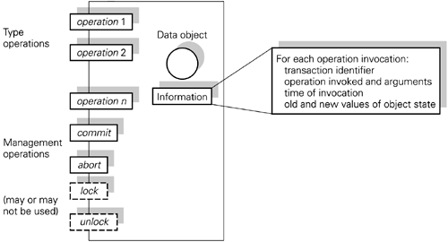
An object model for distributed systems....We assume each object is invoked through operations appropriate to its type.
The figure also shows some object management operations such as commit, abort, lock and unlock which may be needed for practical implementation of a transaction Processing system(TPS)

Slide 6
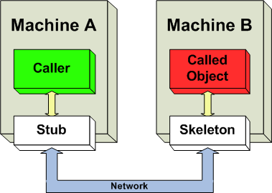
Communication between Distributed Objects
In a distributed computing environment, distributed object communication realizes communication between distributed objects. The main role is to allow objects to access data and invoke methods on remote objects.Invoking a method on a remote object is known as remote method invocation (RMI) or remote invocation, and is the object-oriented programming analog of a remote procedure call (RPC).
Class stubs and skeletons
The widely used approach on how to implement the communication channel is realized by using stubs and skeletons.
They are generated objects whose structure and behavior depends on chosen communication protocol, but in general provide additional functionality that ensures reliable communication over the network.
In RMI, a stub (which is the bit on the client) is defined by the programmer as an interface. The rmic (rmi compiler) uses this to create the class stub. The stub performs type checking. The skeleton is defined in a class which implements the interface stub.

Slide 7
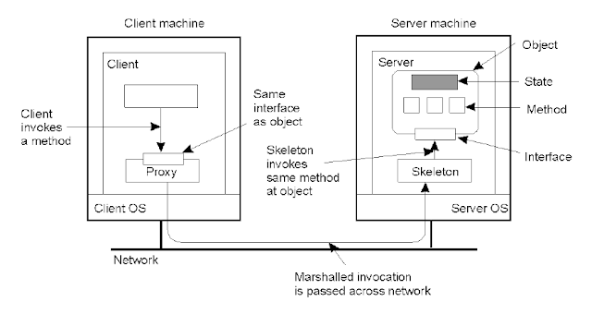
Distributed Object Model
In distributed computing, distributed objects are objects(in the sense of object-oriented programming) that are distributed across different address spaces, either in different processes on the same computer, or even in multiple computers connected via a network, but which work together by sharing data and invoking..

Slide 8
  Design Issues for RMI
Two design issues that arise in extension of local method invocation for RMI
The choice of invocation semantics
    Although local invocations are executed exactly once, this cannot always be the case for RMI due to transmission error.
    Invocation semantics depend upon implementation of Request Reply protocol used by RMI
    Maybe, At-least-once, At-most-once
    Either request or reply message may be lost
    Either server or client may be crashed
The level of transparency
    Make remote invocation as much like local invocation as possible
    Should remote invocations be transparent to the programmer?
    Partial failure, higher latency
    Current consensus: remote invocations should be made transparent in the sense that syntax of a remote invocation is the same as the syntax of local invocation (access transparency) but programmers should be able to distinguish between remote and local objects by looking at their interfaces, e.g., in Java RMI,remote objects implement the Remote interface.

Slide 9
Implementation of RMI
Parameter Passing
Request-Reply Protocol
Handling failures at client and/or server
Supporting persistent objects, object adapters, dynamic invocations, etc.
Communication module
  Two cooperating communication modules carry out the request-reply protocols: message type,requestID,remote object reference
  Transmit request and reply messages between client and server
  Implement specific invocation semantics
The communication module in the server
  selects the dispatcher for the class of the object to be invoked, passes on local reference from remote reference module, returns request.

Slide 10
RMI – Other Topics
Persistent object stores
  An object that is guaranteed to live between activations of process is called a persistent object
  Stored the state of an object in a marshalled (serialized) form on disk
Location service
  Objects can be migrated from one system to another during their lifetime
  Maintains mapping between object references and the location of an object
Distributed Garbage Collection
  Needed for reclaiming space on servers
Passing “behavior”
  Java allows objects (data+code) to be passed by value
    If the class for an object passed by value is not present in a JVM, its code is downloaded automatically
Use of reflection in Java RMI
  Allows construction of generic dispatcher and skeleton

Slide 11
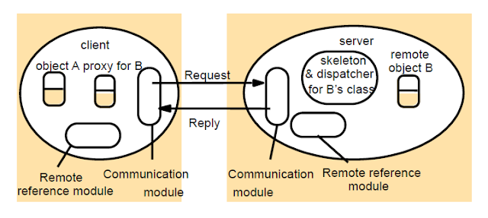
The role of proxy and skeleton in remote method invocation
Stub − A stub is a representation (proxy) of the remote object at client. It resides in the client system; it acts as a gateway for the client program.
Skeleton − This is the object which resides on the server side. stub communicates with this skeleton to pass request to the remote object.
RMI Software Components
Communication module
  Implements the request-reply protocol
Remote reference module
  Responsible for translating between local and remote object references and for creating remote object references
    Maintains remote object table that maintains a mapping between local&remote object references
    E.g., Object Adapter in CORBA
http://mytechroad.com/remote-method-invocation-design-implementation/

Slide 12
RMI – Object Activation
Activation of remote objects
  Some applications require that information survive for long periods of time
  However, objects not in user all the time, so keeping them in running processes is a potential waste of resources
  Object can be activated on demand
    E.g., standard TCP services such as FTP on UNIX machines are activated by inetd
Active and passive objects
  Active objects
    Instantiated in a running processes
  Passive objects
    Not currently active but can be made active
    Implementation of its methods, and marshalled state stored on disk
Activator responsible for
  Registering passive objects that are available for activation
  Starting named server processes and activating remote objects in them
  Keeping track of locations of servers for remote objects that it has already activated
Examples
  CORBA implementation repository
  JAVA RMI has once activator on each server computer

Slide 13
Distributed Garbage Collection
Java approach based on reference counting
  Each server process maintains a list of remote processes that hold remote object references for its remote objects
  When a client first acquires a remote reference to an object, it make addRef() invocation to server before creating a proxy
  When a clients local garbage collector notices that a proxy is no longer reachable, it makes a removeRef() invocation to the server before deleting the proxy
  When the local garbage collector on the server notices that the list of client processes that have a more reference to an object is empty, it will delete the object (unless there are any local objects that have a reference to the object)
Other approaches
  Evictor pattern
  Leases

Slide 14
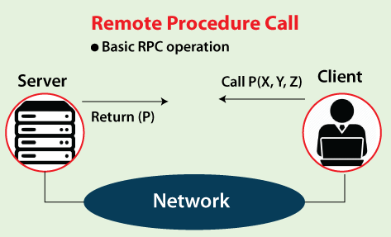
Remote Procedure Call
Remote Procedure Call or RPC is a powerful technique for constructing distributed, client-server-based applications. It is also known as a function call or a subroutine call.
A remote procedure call is when a computer program causes a procedure to execute in a different address space, coded as a local procedure call, without the programmer explicitly stating the details for the remote interaction.
The programmer writes essentially the same code whether the subroutine is local to the executing program or remote. This is a form of client-server interaction implemented via a request-response message-passing system.
The RPC model implies location transparency that calling procedures are largely the same, whether local or remote. Usually, they are not identical, so that local calls can be distinguished from remote calls.
RPCs are a form of inter-process communication (IPC), in that different processes have different address spaces. They have distinct virtual address spaces on the same host machine, even though the physical address space is the same. While if they are on different hosts, the physical address space is different.

Slide 15
Features of RPC
In an operating system, remote procedure call (RPC) has the following features, such as:
  RPC hides the complexity of the message passing process from the user.
  RPC only uses specific layers of the OSI model like the transport layer.
  Clients can communicate with the server by using higher-level languages.
  RPC works well with both local environments and remote environments.
  The program of RPC is written in simple code and is easily understood by the programmer.
  The operating system can handle processes and threads involved in RPC easily.
  The operating system hides the abstractions of RPC from the user.

Slide 16
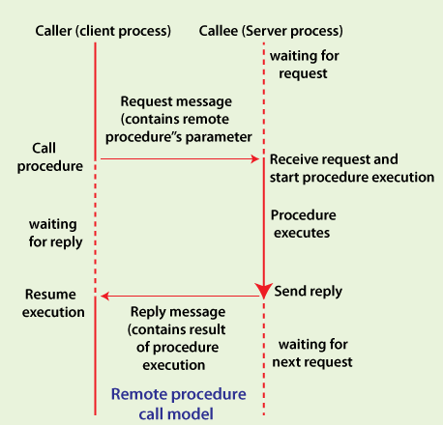
How to Make a Remote Procedure Call
The calling environment is suspended, procedure parameters are transferred across the network to the environment where the procedure is to execute, and the procedure is executed there.
When the procedure finishes and produces its results, it is transferred back to the calling environment, where execution resumes as if returning from a regular procedure call.

Slide 17
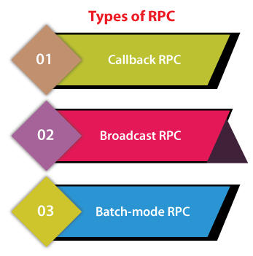
Types of RPC
1. Callback RPC
This type of RPC enables a P2P paradigm between participating processes. It helps a process to be both client and server services.
Callback RPC has the following functions, such as:
  Remotely processed interactive application problems.
  Offers server with clients handle.
  Callback makes the client process wait.
  Manage callback deadlocks.
  It facilitates a peer-to-Peer paradigm among participating processes.
2. Broadcast RPC
Broadcast RPC is a client's request broadcast on the network, processed by all servers with the method for processing that request.
Broadcast RPC has the following functions, such as:
  Allows you to specify that the client's request message has to be broadcast.
  You can declare broadcast ports.
  It helps to reduce the load on the physical network.
3. Batch-mode RPC
Batch-mode RPC helps to queue, separate RPC requests, in a transmission buffer, on the client-side, and then send them on a network in one batch to the server.
Batch-mode RPC has the following functions, such as:
  It minimizes the overhead involved in sending a request by sending them over the network in one batch to the server.
  This type of RPC protocol is only efficient for an application that needs lower call rates.
  It needs a reliable transmission protocol.

Slide 18
Advantages of RPC
Here are some advantages or benefits of RPC, such as:
  RPC method helps clients to communicate with servers by the conventional use of procedure calls in high-level languages.
  The RPC method is modeled on the local procedure call, but the procedure is most likely to be executed in a different process and usually a different computer.
  RPC makes the internal message passing mechanism hidden from the user.
  Remote procedure calls can be used for distribution and the local environment.
  It commits many of the protocol layers to improve performance.
  RPC provides abstraction. For example, the message-passing nature of network communication remains hidden from the user.
  RPC allows the usage of the applications in a distributed environment that is not only in the local environment.
  With RPC code, re-writing and re-developing efforts are minimized.
  Process-oriented and thread-oriented models supported by RPC.

Slide 19
Disadvantages of RPC
Here are some disadvantages or drawbacks of using RPC, such as:
  Remote Procedure Call Passes Parameters by values only and pointer values, which is not allowed.
  Remote procedure calling (and return) time (i.e., overheads) can be significantly lower than a local procedure.
  This mechanism is highly vulnerable to failure as it involves a communication system, another machine, and another process.
  RPC concept can be implemented in different ways, which is can't standard.
  Not offer any flexibility in RPC for hardware architecture as It is mostly interaction-based.
  The cost of the process is increased because of a remote procedure call.

Slide 20
Events and notifications
Publish-subscribe paradigm: publisher sends notifications, i.e. objects representing events
  Subscriber registers interest to receive notifications
The object of interest: where events happen, change of state as a result of its operations being invoked
Events: occurs in the object of interest
Notification: an object containing information about an event
Subscriber: registers interest and receives notifications
Publisher: generate notifications, usually an object of interest
Observer objects: decouple an object of interest from its subscribers (not important)

Slide 21
Events and notifications
Architecture for distributed event notification
Event service object of interest
subscriber
1.
notification
object of interest
observer
subscriber
2.
notification
notification
object of interest
observer
subscriber
3.
notification

Slide 22
Case study: Java RMI
Extends Java object model to support distributed objects
Allows objects to invoke methods in remote objects using the same syntax as for local invocations
Distributed object model is integrated into Java naturally, but the semantics of parameter passing differ because invoker and target are remote
  Input parameters and output parameters
Single language advantage: remote interfaces are defined in Java, do not have to learn IDL (CORBA)

Slide 23
Case study: Java RMI
Shared whiteboard example:
  Allows a group of users to share a common view of a drawing surface containing graphical objects, such as rectangles, lines, circles.
  Each of the graphical objects is drawn by one of the users
  Server maintains current state of a drawing
    provides an operation for clients to inform it about the latest shape
    allows user to retrieve the latest shapes drawn by other users
    allows enquiry about version number so as to avoid fetching shapes they already have
      each shape has a version number attached

Slide 24
Case study: Java RMI
Java Remote interfaces Shape and ShapeList
import java.rmi.*; //package providing Remote interface, must throw RemoteException
import java.util.Vector;
public interface Shape extends Remote { //Shape is a remote interface
int getVersion() throws RemoteException; //returns version number
GraphicalObject getAllState() throws RemoteException; //GraphicalObject serializable
}
public interface ShapeList extends Remote { //ShapeList is a remote interface
Shape newShape(GraphicalObject g) throws RemoteException; // return remote object
Vector allShapes() throws RemoteException; int getVersion() throws RemoteException;
}

Slide 25
Case study: Java RMI
Both ordinary and remote objects can be passed as arguments and results
  Ordinary object (GraphicalObject) is passed by value: all non-remote objects
    New object is created in the receiver’s process, whose methods can be invoked locally, possibly having states changed
  Remote object (Shape) is passed by reference (remote object reference), on which remote methods can be invoked
    newShape: client uses the remote object reference for a remote object of ShapeList, calls its method newShape, passes to it a GraphicObject instance, the server makes a remote object of type Shape containing the state of the graphical object and return a remote object reference to it… so that …

Slide 26
Case study: Java RMI
Downloading of classes: Java is designed to allow classes to be downloaded from one virtual machine to another
  Non-remote object: passed by value. If the recipient does not already have the class of the object, its code is downloaded automatically
  Remote object: passed by reference. If the recipient does not already have the class for a proxy, its code is downloaded automatically
    Recall, we need a proxy as the local representative for each remote object such that remote methods can be invoked
    And, proxy implements the remote interface of the remote object, for local invokers, the proxy looks as if it is the remote object
Advantage: (1) No need for every user to keep the same set of classes in their working environment (2) both client and server can make transparent use of instances of new classes (automatically)

Slide 27
Case study: Java RMI
RMIregistry: binder for Java RMI
  Binder: a separate service in DS, maintains a table containing mappings from textual names to remote object references
Each server hosting remote objects must run an instance of RMIregistry, which is accessed by methods of Naming class
Methods in the Naming class takes as argument a URL-formatted string “ //computerName:port/objectName”
  computerName and port refer to the location of the RMIregistry; if omitted, refer to local computer and default port
  The service is not system-wide, clients must direct their lookup enquiries to particular hosts
  E.g. Naming.rebind(“Shape List”, aShapeList);

Slide 28
Case study: Java RMI
The Naming class of Java RMIregistry
void rebind (String name, Remote obj)
//used by a server to register the identifier of a remote object by name
void bind (String name, Remote obj)
//alternatively used by a server to register a remote object by name, but if the name is already bound to a remote object reference an exception is thrown.
void unbind (String name, Remote obj)
//removes a binding.
Remote lookup(String name)
//used by clients to look up a remote object by name. A remote object reference is returned.
String [] list()
//returns an array of Strings containing the names bound in the registry.

Slide 29
Case study: Java RMI
Classes supporting Java RMI:
Every single servant class needs to extend UnicastRemoteObject
RemoteObject
RemoteServer
Activatable
UnicastRemoteObject
<servant class>

Slide 30
Case study: Java RMI
UnicastRemoteObject
  Automatically creates socket and listens for network requests, and make its services available by exporting them.
RMISecurityManager ()
  Needed to download objects from network. The downloaded objects are allowed to communicate only with sites they came from.
  Default security manager, when none is explicitly set, allows only loading from local file system

Slide 31
Case study: Java RMI
Java class ShapeListServer with main method
import java.rmi.*;
public class ShapeListServer{
public static void main(String args[]){
System.setSecurityManager(new RMISecurityManager()); try{
ShapeList aShapeList = new ShapeListServant(); Naming.rebind("Shape List", aShapeList ); System.out.println("ShapeList server ready");
}catch(Exception e) {
System.out.println("ShapeList server main " + e.getMessage());}
}
}

Slide 32
Java Registry overview
Server machine Client machine Registry server
1. Start rmiregistry
5. Return ref
5a
4. Query by name
6. Invoke RM
Export service
Bind to registry
HTTP
server
5b
Skeleton
Stub (proxy)
dispatcher
32

